Slide 1
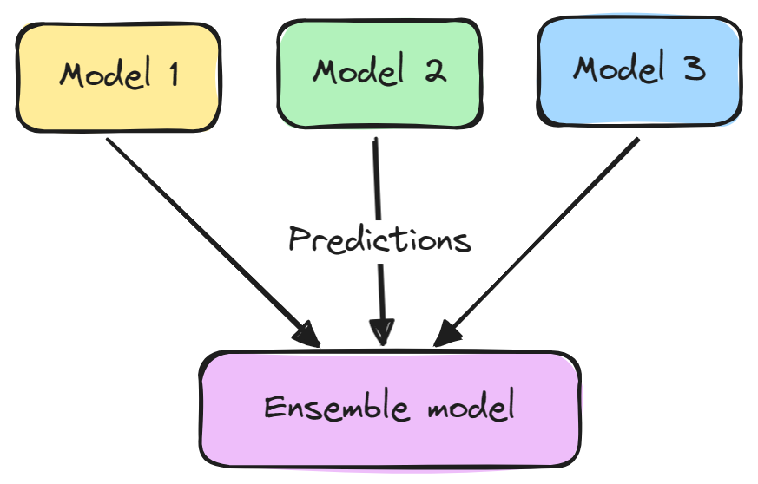
Ensemble learning
Ensemble learning is a machine learning approach that combines multiple individual models to improve the overall performance, accuracy, and robustness of the predictions.
The core idea is that combining several weak models (models that perform slightly better than random guessing) or strong models (more accurate models) will produce a model that performs better than any individual model.
Ensemble learning is particularly useful in reducing overfitting, improving generalization, and handling noisy data.
https://www.datacamp.com/tutorial/what-bagging-in-machine-learning-a-guide-with-examples

Slide 2
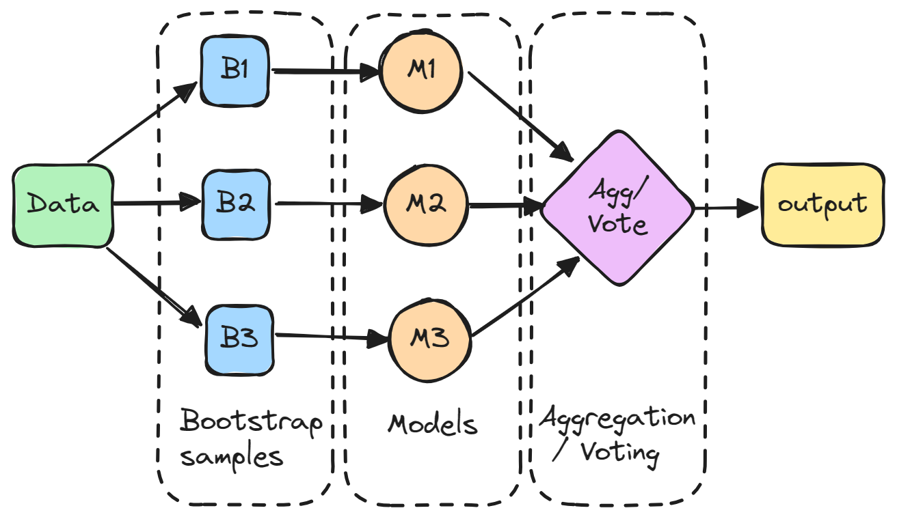
Types of Ensemble Learning Techniques
Bagging (Bootstrap Aggregating)
In bagging, multiple models are trained in parallel on different subsets of the training data (created by randomly sampling with replacement).
Each model’s predictions are combined (averaged or majority voting) to make the final prediction.
Example: Random Forest is a popular bagging algorithm that uses multiple decision trees.
https://www.datacamp.com/tutorial/what-bagging-in-machine-learning-a-guide-with-examples

Slide 3
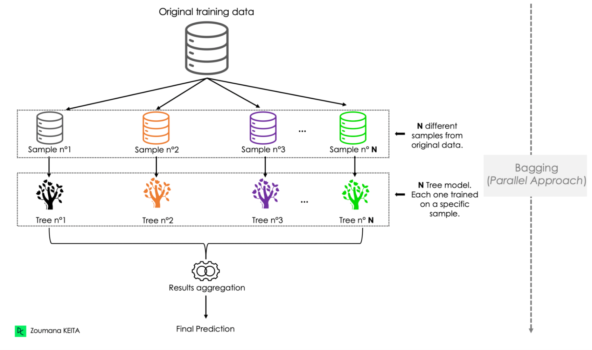
Types of Ensemble Learning Techniques
Bagging (Bootstrap Aggregating)
https://www.datacamp.com/tutorial/what-bagging-in-machine-learning-a-guide-with-examples

Slide 4
Types of Ensemble Learning Techniques
Boosting
Boosting sequentially builds models, with each new model focusing on correcting the errors of the previous one.
Each model is weighted based on its accuracy, and more focus is given to incorrectly classified data points.
Boosting improves model performance and reduces bias.
Examples: AdaBoost, Gradient Boosting, and XGBoost are commonly used boosting algorithms.
https://www.datacamp.com/tutorial/what-bagging-in-machine-learning-a-guide-with-examples

Slide 5
Types of Ensemble Learning Techniques
How Boosting Works
Boosting combines weak learners into a single strong model through a structured process focused on reducing errors in sequential training.
The steps are as follows:
1. Assign Initial Weights: Each data point is initially weighted to reflect its importance in learning
2. Sequential Training: Train the first weak learner on the data, then evaluate its performance. Increase the weights of misclassified instances to encourage the next learner to focus on these harder cases.
3. Repeat the Process: Continue adjusting weights and training additional learners, with each new model addressing the ensemble's current weaknesses.
4. Aggregate Results: Combine predictions from all weak learners, typically in a weighted manner, giving more accurate learners greater influence on the final output.
https://www.datacamp.com/tutorial/what-bagging-in-machine-learning-a-guide-with-examples

Slide 6
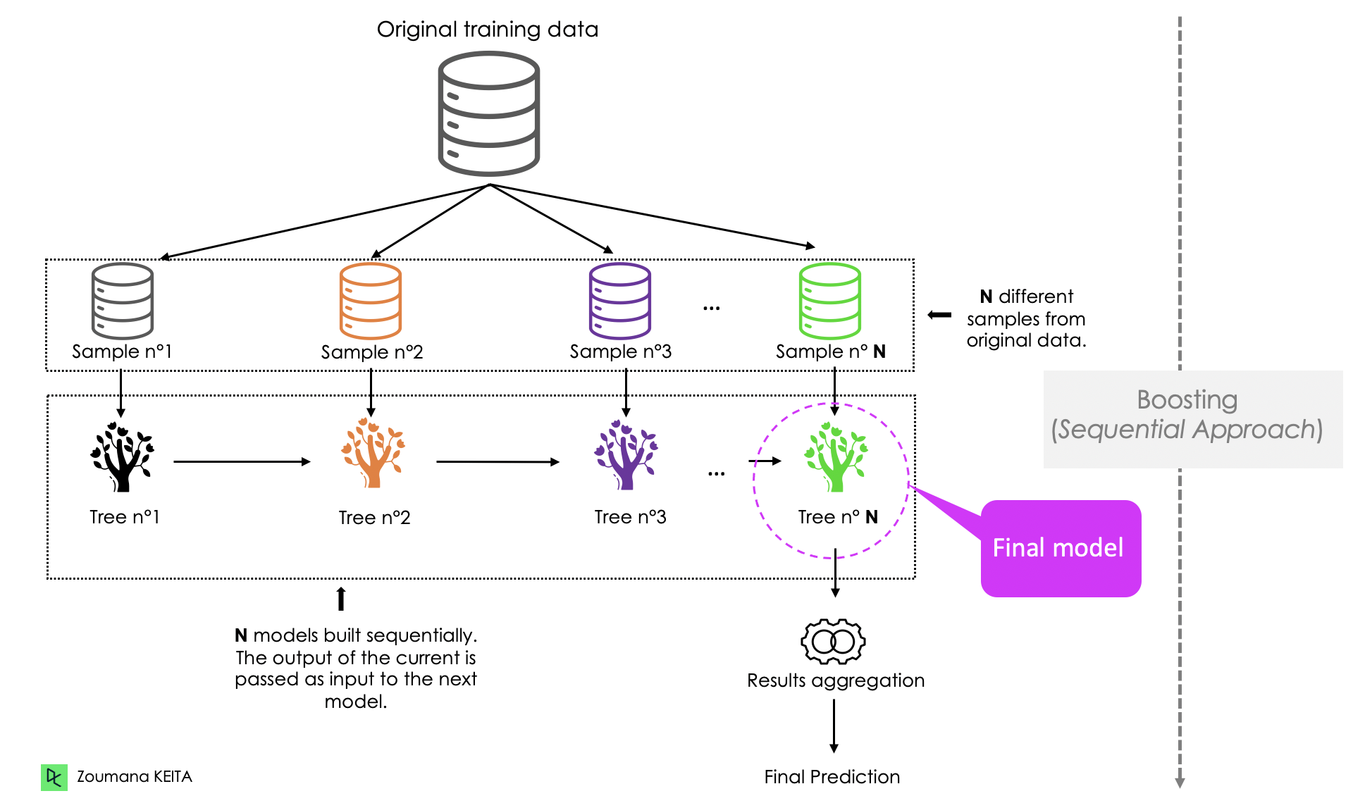
Types of Ensemble Learning Techniques
Boosting
https://www.datacamp.com/tutorial/what-bagging-in-machine-learning-a-guide-with-examples

Slide 7
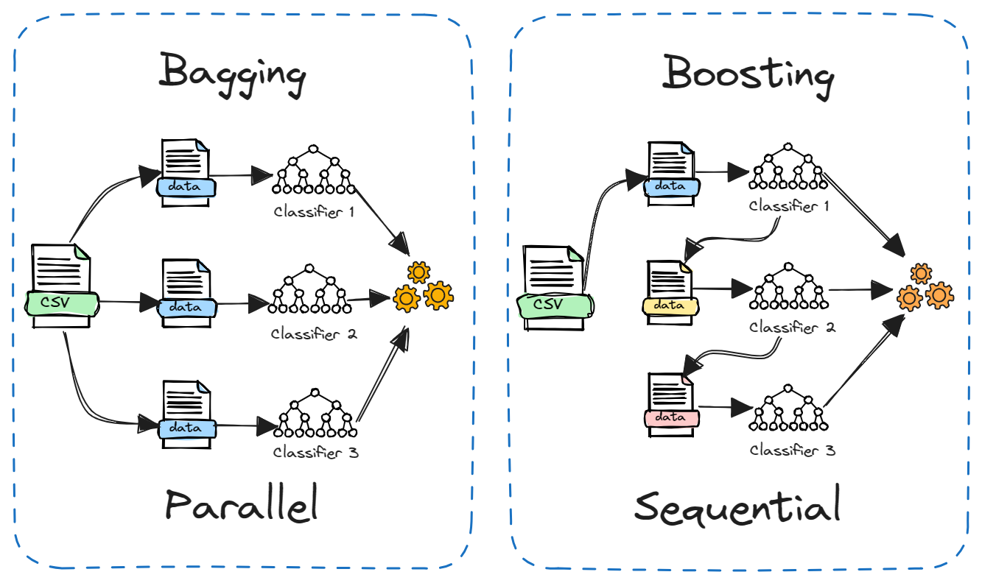
Types of Ensemble Learning Techniques
Bagging vs. Boosting
Bagging usually combines models through simple averaging, while boosting assigns weights to models based on their accuracy.
https://www.datacamp.com/tutorial/what-bagging-in-machine-learning-a-guide-with-examples

Slide 8
Types of Ensemble Learning Techniques
Stacking (Stacked Generalization)
In stacking, different models (of varying types) are trained on the same dataset, and a meta-model is then trained to combine their outputs.
This meta-model learns the best way to combine the predictions from the individual models.
Unlike bagging and boosting, stacking allows for using different algorithms, which helps capture diverse patterns in the data.
Example: Using a combination of decision trees, logistic regression, and SVMs as base models, with a linear regression as the meta-model.
https://www.datacamp.com/tutorial/what-bagging-in-machine-learning-a-guide-with-examples

Slide 9
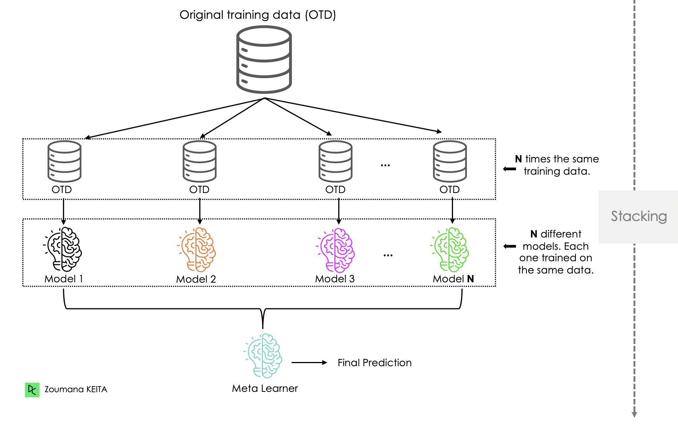
Types of Ensemble Learning Techniques
Stacking (Stacked Generalization)
https://www.datacamp.com/tutorial/what-bagging-in-machine-learning-a-guide-with-examples

Slide 10
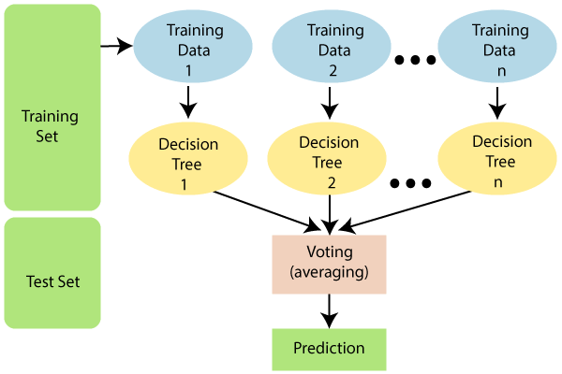
Random Forest
Random Forest is an ensemble learning algorithm primarily used for classification and regression tasks.
It combines multiple decision trees to create a more accurate, robust, and less overfitting-prone model.
The underlying concept is based on bagging (bootstrap aggregating), where each decision tree is trained on a different random subset of the training data, and the final prediction is made by averaging or taking a majority vote of the predictions from all trees.
https://www.javatpoint.com/machine-learning-random-forest-algorithm

Slide 11
Random Forest
Key Features of Random Forest
Random Subsampling of Data:
Each decision tree is trained on a randomly selected subset of the training data with replacement (bootstrapping).
This ensures each tree has slightly different data, leading to diverse trees that capture various patterns in the dataset.
Feature Randomness:
For each split within a tree, only a random subset of features is considered rather than the full feature set.
This feature randomness helps reduce the correlation between trees, improving overall model performance and preventing overfitting.

Slide 12
Random Forest
Key Features of Random Forest
Prediction Aggregation:
For classification, each tree votes for a class, and the class with the most votes becomes the final prediction.
For regression, predictions from all trees are averaged to get the final result.

Slide 13
Random Forest
Key Features of Random Forest
Prediction Aggregation:
For classification, each tree votes for a class, and the class with the most votes becomes the final prediction.
For regression, predictions from all trees are averaged to get the final result.
Colab Implementation: Click here

Slide 14
Performance Measure in Classification
After building a model with a learning algorithm using the training set, how can you determine its effectiveness?
The test set is used for this evaluation. Since the test set includes examples the learning algorithm hasn’t seen before, good performance on predicting these labels suggests that the model generalizes well—in other words, it’s a strong model.
Machine learning specialists use formal metrics to evaluate model performance. For classification, the most widely used metrics and tools to assess the classification model are:
confusion matrix,
accuracy,
cost-sensitive accuracy,
precision/recall, and
area under the ROC curve

Slide 15
Performance Measure in Classification
Confusion Matrix
The confusion matrix is a table that shows how well a classification model predicts examples across different classes. One axis represents the model’s predicted labels, and the other axis shows the actual labels.
In binary classification, with two classes (for example, “spam” and “not_spam”), this matrix provides a summary of the model’s performance.
 | Spam (predicted) | Not_spam (predicted)
Spam (actual) | 23 (TP) | 1 (FN)
Not_spam (actual) | 12 (FP) | 556 (TN)

Slide 16
Performance Measure in Classification
Confusion Matrix
The above confusion matrix shows that of the 24 examples that actually were spam, the model correctly classified 23 as spam. In this case, we say that we have 23 true positives or TP = 23. The model incorrectly classified 1 example as not_spam. In this case, we have 1 false negative, or FN = 1.
Similarly, of 568 examples that actually were not spam, 556 were correctly classified (556 true negatives or TN = 556), and 12 were incorrectly classified (12 false positives, FP = 12).
 | Spam (predicted) | Not_spam (predicted)
Spam (actual) | 23 (TP) | 1 (FN)
Not_spam (actual) | 12 (FP) | 556 (TN)

Slide 17
Performance Measure in Classification
Confusion Matrix
The confusion matrix for multiclass classification has as many rows and columns as there are different classes. It can help you to determine mistake patterns.
For example, a confusion matrix could reveal that a model trained to recognize different species of animals tends to mistakenly predict “cat” instead of “panther,” or “mouse” instead of “rat.”
In this case, you can decide to add more labeled examples of these species to help the learning algorithm to “see” the difference between them.
Alternatively, you might add additional features the learning algorithm can use to build a model that would better distinguish between these species.

Slide 18
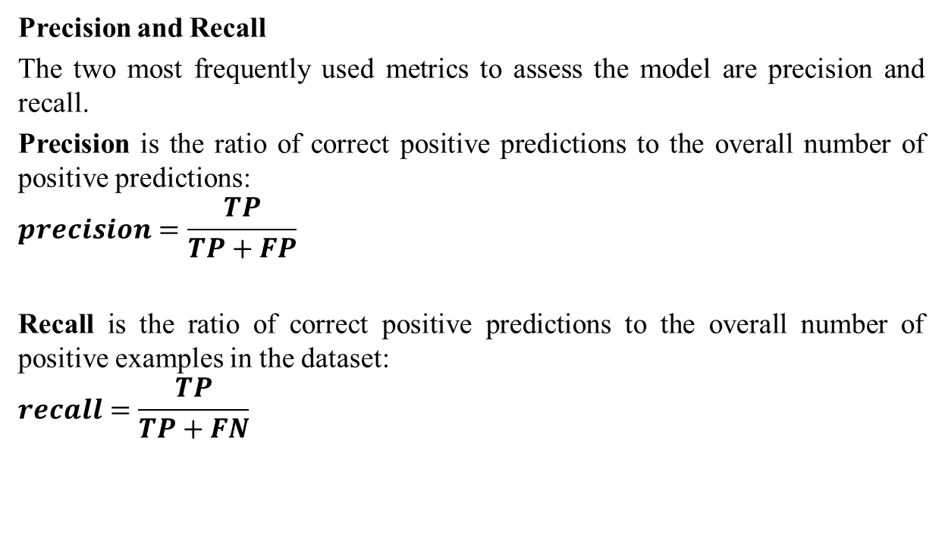
Performance Measure in Classification
Precision and Recall
The two most frequently used metrics to assess the model are precision and recall.
Precision is the ratio of correct positive predictions to the overall number of positive predictions:
$$precision=\frac{TP}{TP+FP}$$
Recall is the ratio of correct positive predictions to the overall number of positive examples in the dataset:
$$recall=\frac{TP}{TP+FN}$$

Slide 19
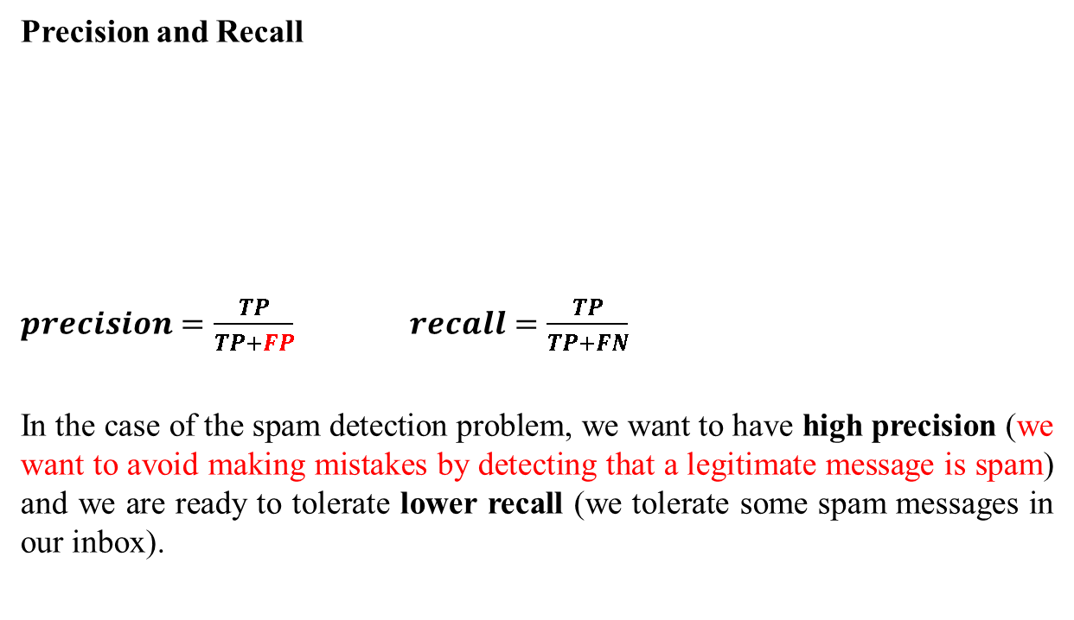
Performance Measure in Classification
Precision and Recall
$precision=\frac{TP}{TP+FP}$ $recall=\frac{TP}{TP+FN}$
In the case of the spam detection problem, we want to have high precision (we want to avoid making mistakes by detecting that a legitimate message is spam) and we are ready to tolerate lower recall (we tolerate some spam messages in our inbox).
 | Spam (predicted) | Not_spam (predicted)
Spam (actual) | 23 (TP) | 1 (FN)
Not_spam (actual) | 12 (FP) | 556 (TN)

Slide 20
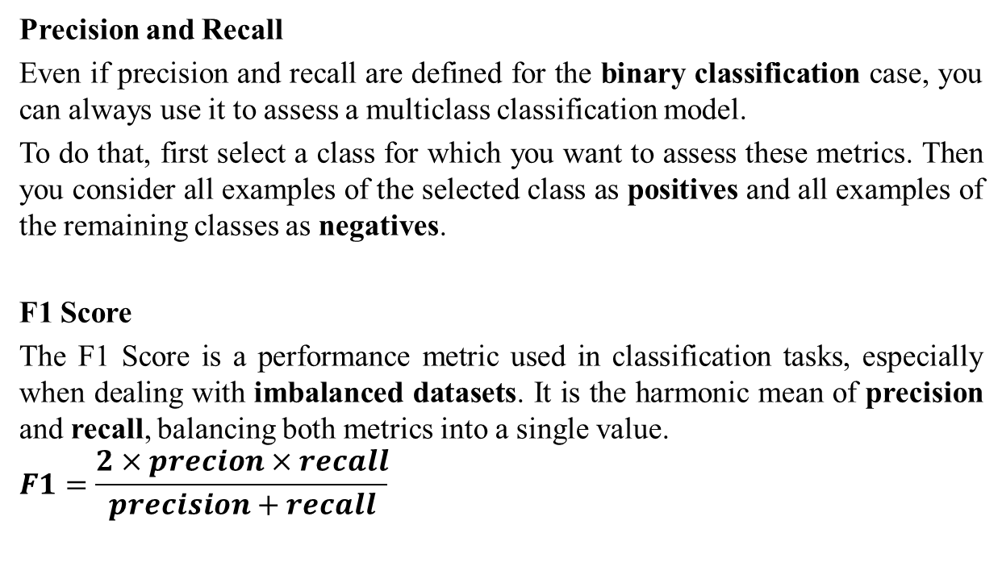
Performance Measure in Classification
Precision and Recall
Even if precision and recall are defined for the binary classification case, you can always use it to assess a multiclass classification model.
To do that, first select a class for which you want to assess these metrics. Then you consider all examples of the selected class as positives and all examples of the remaining classes as negatives.
F1 Score
The F1 Score is a performance metric used in classification tasks, especially when dealing with imbalanced datasets. It is the harmonic mean of precision and recall, balancing both metrics into a single value.
$$F1=\frac{2×precion×recall}{precision+recall}$$

Slide 21
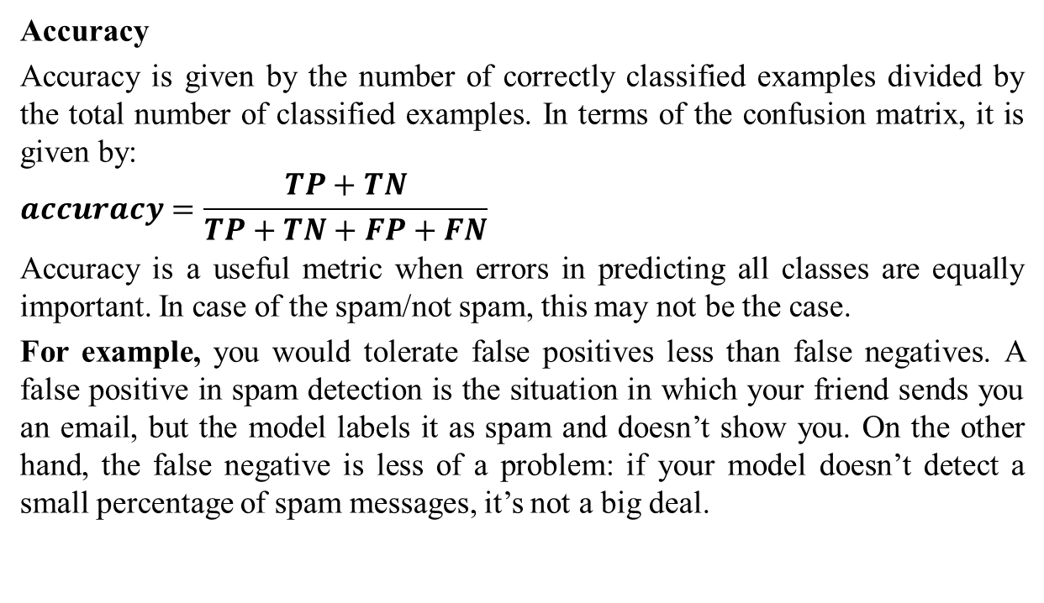
Performance Measure in Classification
Accuracy
Accuracy is given by the number of correctly classified examples divided by the total number of classified examples. In terms of the confusion matrix, it is given by:
$$accuracy=\frac{TP+TN}{TP+TN+FP+FN}$$
Accuracy is a useful metric when errors in predicting all classes are equally important. In case of the spam/not spam, this may not be the case.
For example, you would tolerate false positives less than false negatives. A false positive in spam detection is the situation in which your friend sends you an email, but the model labels it as spam and doesn’t show you. On the other hand, the false negative is less of a problem: if your model doesn’t detect a small percentage of spam messages, it’s not a big deal.

Slide 22
Performance Measure in Classification
Choice of metric and tradeoffs
The metric(s) you choose to prioritize when evaluating the model and choosing a threshold depend on the costs, benefits, and risks of the specific problem.
In the spam classification example, it often makes sense to prioritize recall, picking all the spam emails, or precision, trying to ensure that spam-labeled emails are in fact spam, or some balance of the two, above some minimum accuracy level.
Metric | Guidance
Accuracy | Use as a rough indicator of model training progress/convergence for balanced datasets. For model performance, use only in combination with other metrics. Avoid for imbalanced datasets. Consider using another metric.
Recall (True positive rate) | Use when false negatives are more expensive than false positives.
False positive rate | Use when false positives are more expensive than false negatives.
Precision | Use when it's very important for positive predictions to be accurate.

Slide 23
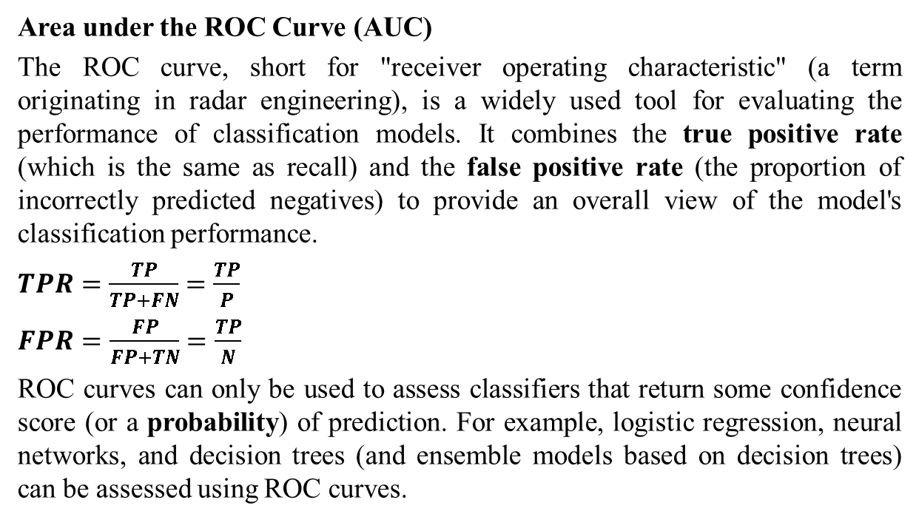
Performance Measure in Classification
Area under the ROC Curve (AUC)
The ROC curve, short for "receiver operating characteristic" (a term originating in radar engineering), is a widely used tool for evaluating the performance of classification models. It combines the true positive rate (which is the same as recall) and the false positive rate (the proportion of incorrectly predicted negatives) to provide an overall view of the model's classification performance.
$TPR=\frac{TP}{TP+FN}$ $=\frac{TP}{P}$
$FPR=\frac{FP}{FP+TN}$ $=\frac{TP}{N}$
ROC curves can only be used to assess classifiers that return some confidence score (or a probability) of prediction. For example, logistic regression, neural networks, and decision trees (and ensemble models based on decision trees) can be assessed using ROC curves.

Slide 24
Performance Measure in Classification
Area under the ROC Curve (AUC)
To draw a ROC curve, you first discretize the range of the confidence score. If this range for a model is [0,1], then you can discretize it like this: [0, 0.1, 0.2, 0.3, 0.4, 0.5, 0.6, 0.7, 0.8, 0.9, 1].
Each discrete value is used as a prediction threshold to classify examples in the dataset. For instance, to compute TPR and FPR with a threshold of 0.7, the model generates a score for each example. If the score is 0.7 or higher, the example is classified as the positive class; otherwise, it is classified as the negative class.
The higher the area under the ROC curve (AUC), the better the classifier. A classifier with an AUC higher than 0.5 is better than a random classifier. If AUC is lower than 0.5, then something is wrong with your model. A perfect classifier would have an AUC of 1.

Slide 25
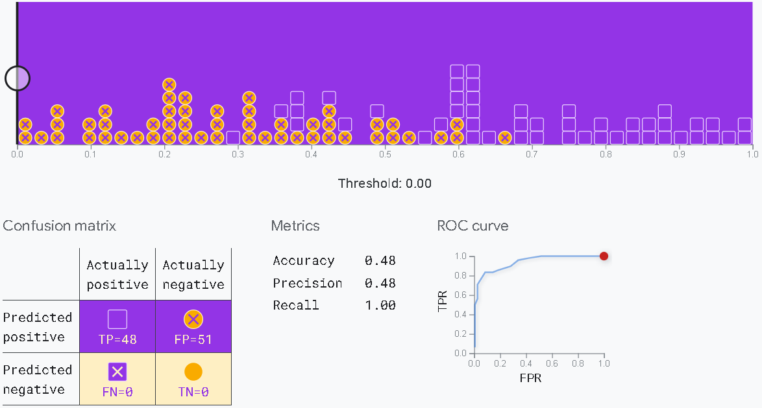
Performance Measure in Classification
Area under the ROC Curve (AUC)
https://developers.google.com/machine-learning/

Slide 26
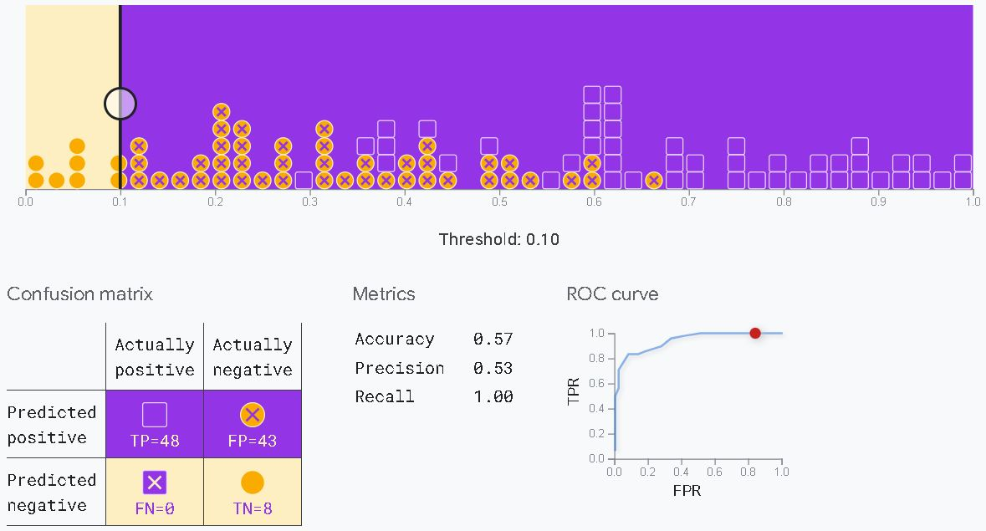
Performance Measure in Classification
Area under the ROC Curve (AUC)

Slide 27
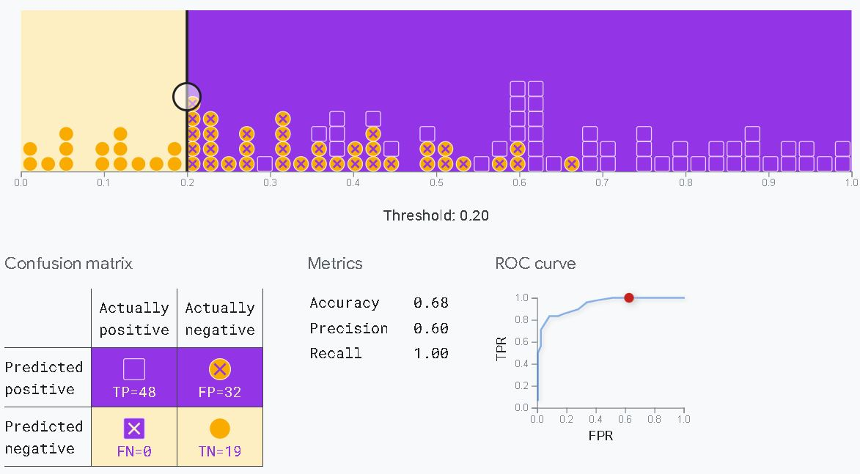
Performance Measure in Classification
Area under the ROC Curve (AUC)

Slide 28
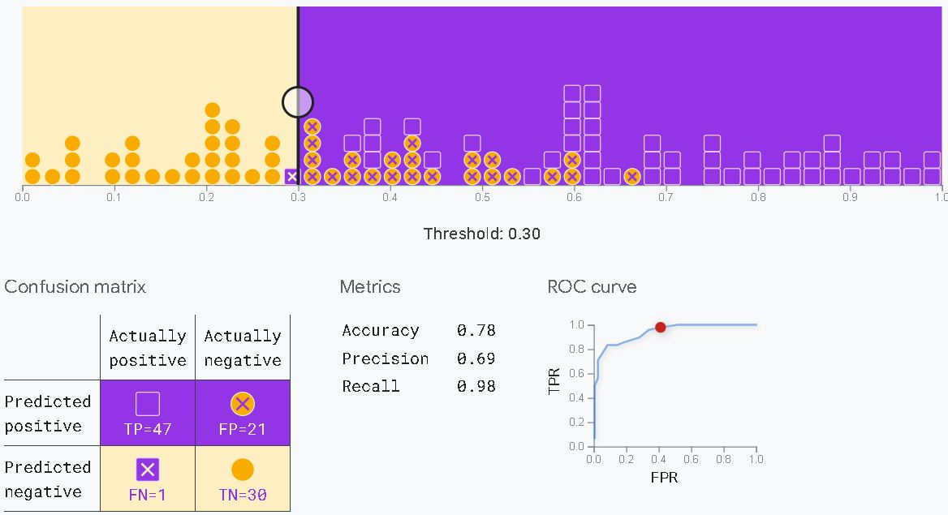
Performance Measure in Classification
Area under the ROC Curve (AUC)

Slide 29
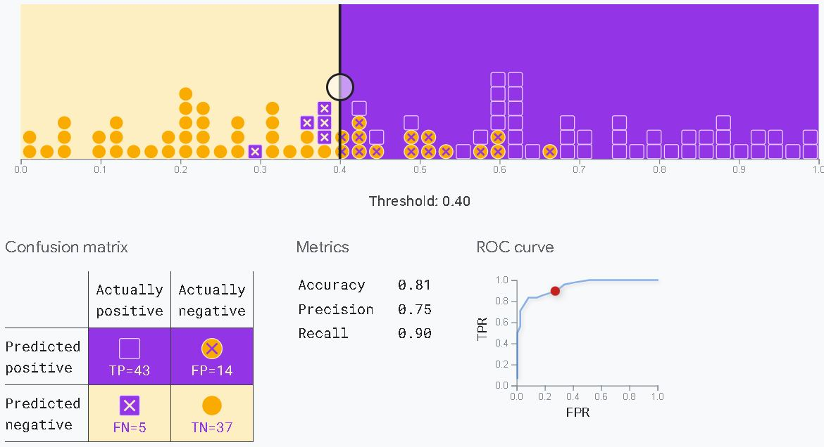
Performance Measure in Classification
Area under the ROC Curve (AUC)

Slide 30
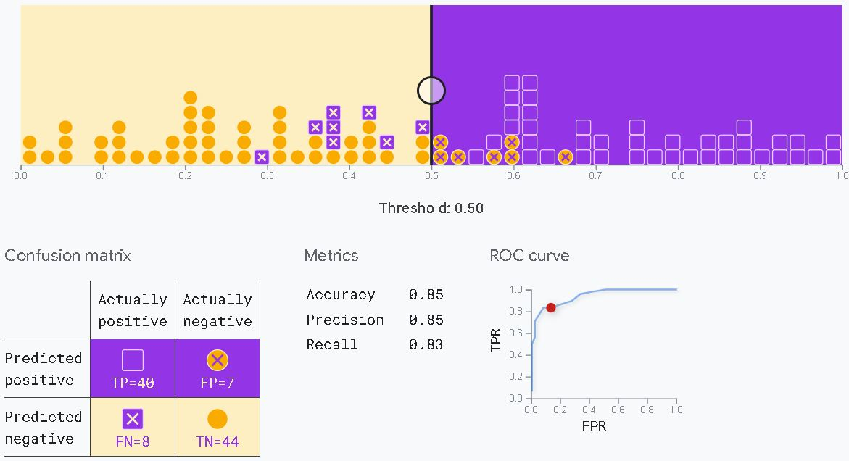
Performance Measure in Classification
Area under the ROC Curve (AUC)

Slide 31
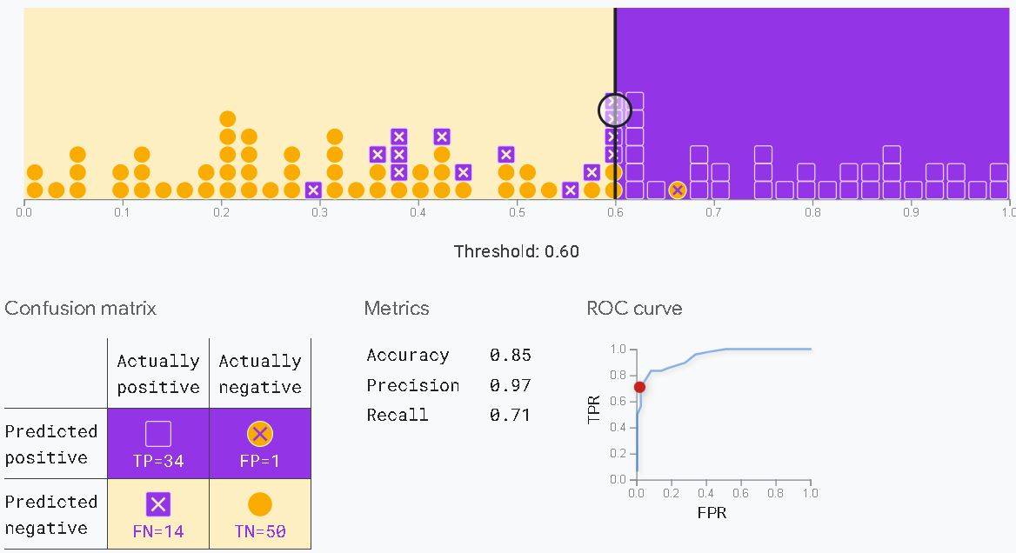
Performance Measure in Classification
Area under the ROC Curve (AUC)

Slide 32
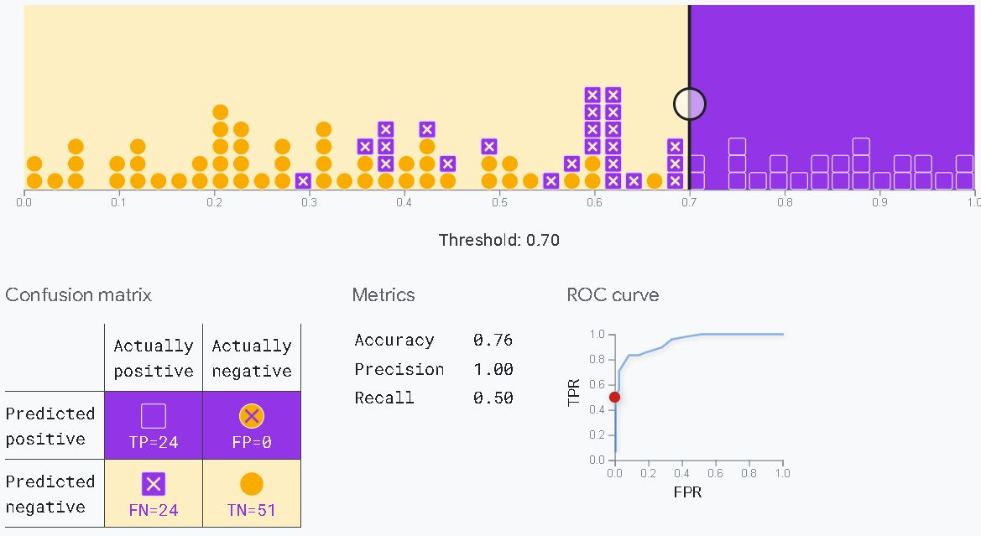
Performance Measure in Classification
Area under the ROC Curve (AUC)

Slide 33
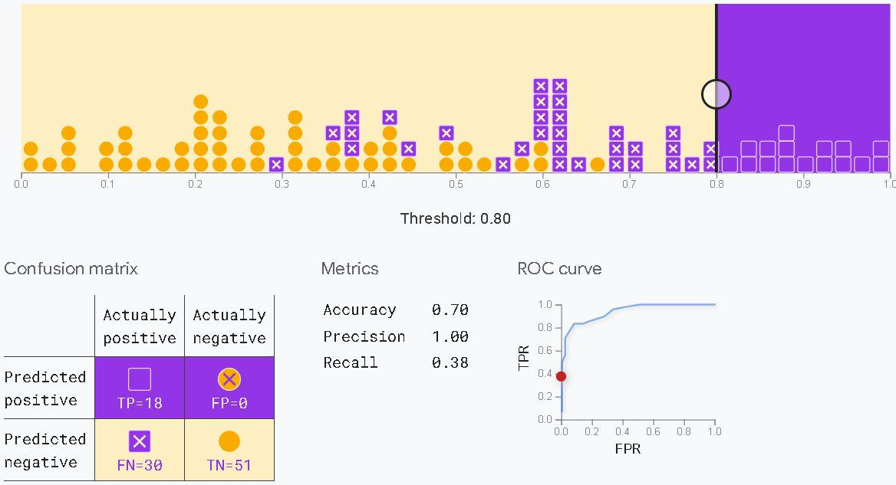
Performance Measure in Classification
Area under the ROC Curve (AUC)

Slide 34
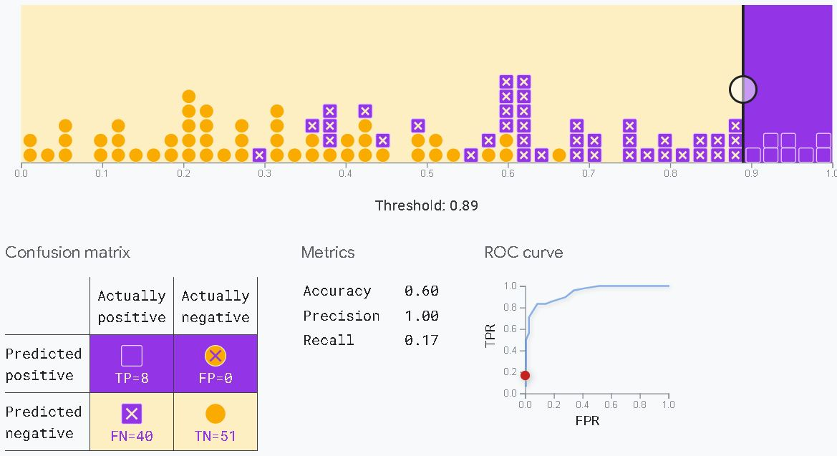
Performance Measure in Classification
Area under the ROC Curve (AUC)

Slide 35
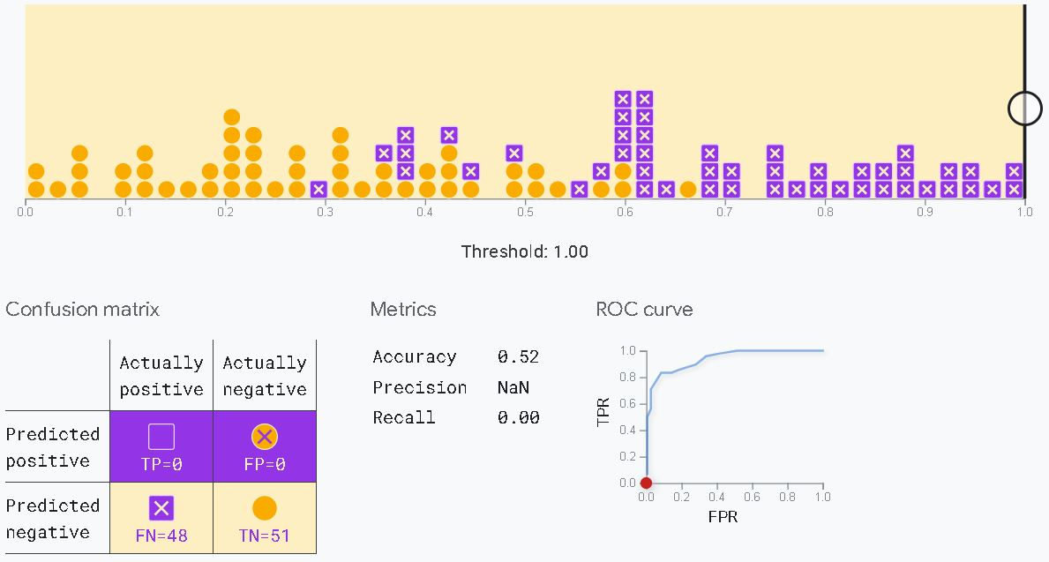
Performance Measure in Classification
Area under the ROC Curve (AUC)

Slide 36
Performance Measure in Classification
Training Loss
Training Loss is a key metric in machine learning that quantifies the error made by a model on the training dataset. It indicates how well the model is learning from the training data and reflects the difference between the model’s predictions and the actual values for each example.
How Training Loss Works:
Initial Calculation: During training, after each pass of the model on the training data (forward pass), the difference between the predicted outputs and actual labels is measured using a loss function (e.g., mean squared error for regression or cross-entropy for classification).
Optimization: This training loss is used by the optimization algorithm (e.g., gradient descent) to adjust the model’s parameters (weights and biases) to reduce this error.
Expected Trend: Ideally, training loss decreases over time, indicating the model is learning patterns in the data.

Slide 37
Performance Measure in Classification
Importance of Training Loss
Model Feedback:
Training loss gives immediate feedback on whether the model is improving with each training step.
Overfitting and Underfitting:
Low training loss means the model fits the training data well. However, if training loss is low but validation loss is high, this signals overfitting (the model is not generalizing well to new data).
Types of Loss Functions:
Mean Squared Error (MSE): Common for regression tasks.
Cross-Entropy Loss: Common in classification tasks.
Hinge Loss: Often used for support vector machines.

Slide 38
Hyper-parameter vs. parameter
Hyper-parameter vs. parameter
In machine learning, parameters and hyperparameters are two distinct types of settings within a model, each impacting how the model learns and performs.
Parameters
Definition: Parameters are internal values learned from the training data. They are adjusted during training and are used directly by the model to make predictions.
Examples: In a linear regression model, parameters are the coefficients (slopes) and intercepts; in a neural network, parameters are the weights and biases.
Purpose: Parameters capture the relationships in the data and define the model's mapping from input to output.
Tuning: These are not manually set; they are optimized automatically by the model's learning algorithm.

Slide 39
Hyper-parameter vs. parameter
Hyperparameters
Definition: Hyperparameters are settings chosen before the training process starts, influencing how the model learns. They are not learned from the data and must be specified by the user.
Examples: In a neural network, the learning rate, number of hidden layers, and batch size are hyperparameters; for a decision tree, the maximum depth and minimum samples per leaf are hyperparameters.
Purpose: Hyperparameters control the model's complexity and learning process, impacting both training efficiency and performance.
Tuning: They are set manually and often optimized through methods like grid search or random search.
Key Differences
Parameters are learned from data, while hyperparameters are set before training.
Parameters are automatically adjusted during training; hyperparameters require manual tuning.

Slide 40
Hyperparameter Tuning
Hyperparameter Tuning
Often, the optimal model architecture for a given problem isn't immediately clear, so exploring a variety of options is beneficial. Ideally, you'd want the machine to automatically conduct this exploration and select the best model architecture.
This process of finding the best set of hyperparameters is known as "Hyperparameter Optimization" or "Hyperparameter Tuning.“
Models often have numerous hyperparameters, and identifying the best combination can be approached as a search problem.
Although there are various hyperparameter optimization methods available, this discussion focuses on two straightforward strategies: (1) Grid Search and (2) Random Search.

Slide 41
Hyperparameter Tuning
Grid searching of hyperparameters
Grid search is a hyperparameter tuning method that systematically builds and evaluates a model for each possible combination of specified hyperparameter values arranged in a grid.
For example, consider a machine learning model X that has three hyperparameters: 𝑎1​, 𝑎2​, and 𝑎3. In grid search, you define a range of values for each hyperparameter. This set of values forms a "grid." Grid search then builds various versions of model X by combining each possible set of values across 𝑎1, 𝑎2, and 𝑎3.
Suppose the grid is defined as follows:
a1 = [0,1,2,3,4,5]
a2 = [10,20,30,40,5,60]
a3 = [105,105,110,115,120,125]
Grid search will begin with the combination [0,10,105and end with [5,60,125], evaluating all intermediate combinations. It’s important to ensure that each hyperparameter value in the grid is valid (e.g., integer-only values if the hyperparameter requires integers). This approach, while thorough, can be computationally expensive due to the large number of combinations.

Slide 42
Hyperparameter Tuning
Random searching of hyperparameters
Random search differs from a grid search. In that you longer provide a discrete set of values to explore for each hyperparameter; rather, you provide a statistical distribution for each hyperparameter from which values may be randomly sampled.
In random search, you define a sampling distribution for each hyperparameter and set the number of iterations to try when searching for the optimal model. In each iteration, hyperparameter values are chosen by sampling from these defined distributions.
The primary rationale behind using random search instead of grid search is that, in most cases, hyperparameters do not contribute equally to model performance, so random sampling can often find a better combination faster.

